Slide 1
Artificial Intelligence Techniques
Informed Search

Slide 2
Outline
Search Problems
Search trees and state space graphs
Uninformed search
  Depth-first, Breadth-first, Uniform cost
  Search graphs
Informed search
  Greedy search, A* search
  Heuristics, admissibility
Local search and optimization
  Hill-climbing
  Simulated annealing
  Genetic algorithms

Slide 3
Disciplines which form the core of AI- inner circle
Fields which draw from these disciplines- outer circle.
Robotics
NLP
Search,
KR & Reasoning,
Machine Learning,
Expert
Systems
Planning
Computer
Vision

Slide 4
Uninformed vs. informed search
Uninformed search (or, blind search)
  Uses only the information available in the problem definition
  Uses no knowledge about which path is likely to be best
  E.g. BFS, DFS, uniform cost etc.
Informed search (or, heuristic search)
  Knows whether a non-goal state is more promising
  E.g. Greedy search, A* Search etc.
  Searches through the space of possible solutions

Slide 5
What are heuristics?
Problem-specific knowledge that reduces
expected search effort

Slide 6
Heuristic
Webster's Revised Unabridged Dictionary (1913)
  Heuristic \Heu*ris"tic\, a. [Greek. to discover.] Serving to discover or find out.
The Free On-line Dictionary of Computing
  heuristic 1. <programming> A rule of thumb, simplification or educated guess that reduces or limits the search for solutions in domains that are difficult and poorly understood. Unlike algorithms, heuristics do not guarantee feasible solutions and are often used with no theoretical guarantee. 2. <algorithm> approximation algorithm.
From WordNet (r) 1.6
  heuristic adj 1: (computer science) relating to or using a heuristic rule 2: of or relating to a general formulation that serves to guide investigation [ant: algorithmic] n : a commonsense rule (or set of rules) intended to increase the probability of solving some problem [syn: heuristic rule, heuristic program]

Slide 7
Heuristics (some examples)
Travel planning
  Euclidean distance
8-puzzle
  Manhattan distance (how far the goal is?)
  No. of misplaced tiles
Travelling salesman problem
  Minimum spanning tree

Slide 8
Best-first search
An instance of the general tree search
Idea: use an evaluation function f(n) for each node
  Estimate of "desirability“
Implementation:
  Priority queue: Order the nodes in fringe in ascending order of f-values
Key component: heuristic function (h(n))
  h(n)= estimated cost of the cheapest path from node n to the goal
  Most common form in which additional knowledge of the problem is imparted
Special cases:
  greedy best-first search
  A* search
  Expand most desirable unexpanded node, i.e. node with lowest f(n)

Slide 9
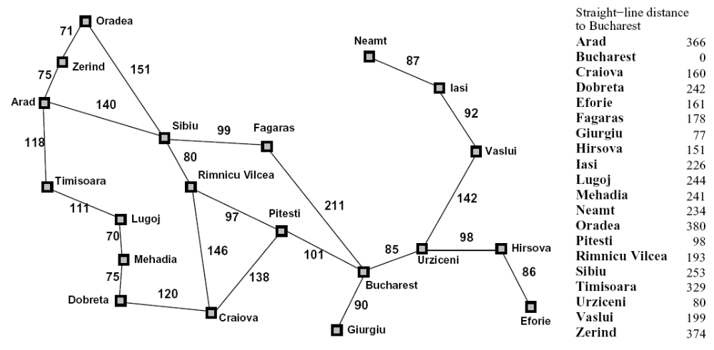
Heuristics

Slide 10
Greedy best-first search
Greedy best-first search expands the node that appears to be closest to goal
Evaluation function f(n) = h(n) (heuristic)
= estimate of cost from n to goal
e.g., h_{SLD}(n) = straight-line distance in the route-finding problem
Finds the solution quickly

Slide 11
Heuristics

Slide 12
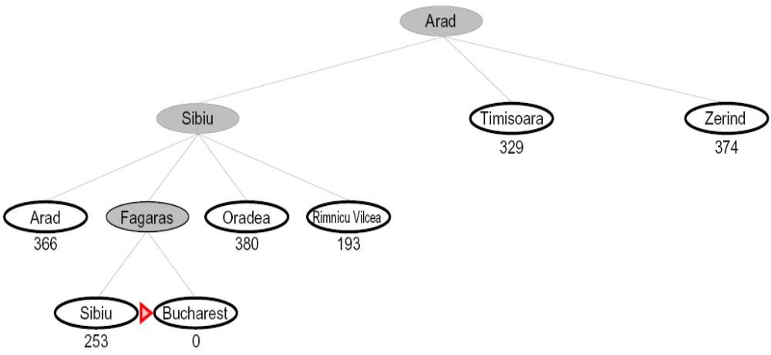

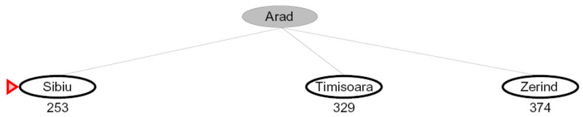
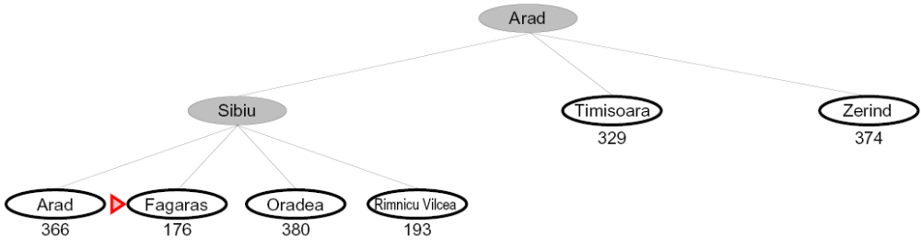
Greedy Best First Search
What can go wrong?

Slide 13
Heuristics

Slide 14
Greedy Best First Search
A common case:
  Can guide to non-optimal solution
  Path via Sibiu → Fagars →Bucharest is 32 km longer than through Rimnicu Vilcea→Pitesi
(99+211)-(80+97+101)=32
Minimizing h(n) is susceptible to false starts (unnecessary nodes are expanded)
  E.g. Iasi→Fagras
  According to heuristic, Neamt is expanded but it is dead end!
  Solution: Vaslui (farther from goal)→Urziceni→Bucharest→Fagras
Worst-case: like a badly-guided DFS
  Can explore everything
  Can get stuck in loops if no cycle checking
    e.g., Iasi → Neamt → Iasi → Neamt
  Can go infinite path and never try other possibilities

Slide 15
Heuristics

Slide 16
Best First Greedy Search
Algorithm | Complete | Optimal | Time | Space
Greedy Best-First Search
Y*
N
O(b^{m})
O(b^{m})
b
…
m
What do we need to do to make it complete? (repeated cycle check)
Can we make it optimal?

Slide 17
Combining UCS and Greedy
Uniform-cost orders by path cost, or backward cost g(n)
Best-first orders by distance to goal, or forward cost h(n)
A* Search orders by the sum: f(n) = g(n) + h(n)
5
e
h=1
1
1
3
2
S
a
d
G
h=6
1
h=5
h=2
h=0
1
c
b
h=7
h=6

Slide 18

Algorithm A
A function f is maintained with each node
  f(n) = g(n) + h(n), n is the node in the open list
Node chosen for expansion is the one with least f value
For BFS: h = 0, g = number of edges in the path to S
For DFS: h = 0, g =

Slide 19
Algorithm A*
One of the most important advances in AI
  Idea: avoid expanding paths that are already expensive
g(n) = least cost path to n from S found so far
h(n) <= h*(n) where h*(n) is the actual cost of optimal path to G(node to be found) from n
“Optimism leads to optimality”
S
g(n)
n
h(n)
G

Slide 20
Heuristics

Slide 21

A* search example

Slide 22

A* search example

Slide 23

A* search example

Slide 24

A* search example

Slide 25

A* search example

Slide 26

A* search example

Slide 27
When should A* terminate?
Should we stop when we enqueue a goal?
No: only stop when we dequeue a goal
A
2
2
h = 2
S
G
h = 3
B
h = 0
2
3
h = 1

Slide 28
Is A* Optimal?
1
A
3
h = 6
h = 0
S
h = 7
G
5
What went wrong?
Actual bad path cost (5) < estimated good path cost (1+6)
We need estimates (h=7) to be less than
actual (5) costs!

Slide 29


Admissible Heuristics
A heuristic h is admissible (optimistic) if:
where is the true cost to a nearest goal
Never overestimate!
Optimistic: cost of solution is less than the actual cost!
Example: h_{SLD}(n) (never overestimates the actual road distance)
Theorem: If h(n) is admissible, A* using TREE-SEARCH is optimal

Slide 30

Optimality of A* (proof)
Suppose some suboptimal goal G₂ has been generated and is in the fringe. Let n be an unexpanded node in the fringe such that n is on a shortest path to an optimal goal G
f(G₂) = g(G₂) since h(G₂) = 0
g(G₂) > g(G) since G₂ is suboptimal
f(G) = g(G) since h(G) = 0
f(G₂) > f(G) from above

Slide 31
Optimality of A* (proof)
Suppose some suboptimal goal G₂ has been generated and is in the fringe. Let n be an unexpanded node in the fringe such that n is on a shortest path to an optimal goal G
f(n)=g(n)+h(n) ≤ f(G) since h is admissible
Hence f(G₂) > f(n), and A* will never select G₂ for expansion

Slide 32
BUT … graph search
Discards new paths to repeated state
  Previous proof breaks down
  First one may not lead to the optimal one and so can be a problem
Solution:
  Add extra bookkeeping i.e. remove more expensive of two paths
  Ensure that optimal path to any repeated state is always first followed
    Extra requirement on h(n): consistency (monotonicity)

Slide 33

Consistent heuristics
A heuristic is consistent (or, monotonic) if for every node n, every successor n' of n generated by any action a,
h(n) ≤ c(n,a,n') + h(n')
-general form of triangle inequality
-straight line distance
If h is consistent, we have
f(n') = g(n') + h(n')
= g(n) + c(n,a,n') + h(n')
≥ g(n) + h(n)
= f(n)
Theorem: If h(n) is consistent, A* using GRAPH-SEARCH is optimal
i.e., f(n) is non-decreasing along any path (so the first goal node expanded is always least expensive)

Slide 34
A* search (properties)
Completeness: YES
  Since bands of increasing f are added
  Unless there are infinitely many nodes with f<f(G)

Slide 35
A* search (properties)
Completeness: YES
Time complexity:
  Number of nodes expanded is still exponential in the length of the solution

Slide 36
A* search (properties)
Completeness: YES
Time complexity: (exponential with path length)
Space complexity:
  It keeps all generated nodes in memory
  Hence space is the major problem not time

Slide 37
A* search (properties)
Completeness: YES
Time complexity: exponential with path length
Space complexity: all nodes are stored
Optimality: YES
  Cannot expand f_{i+1} until f_{i} is finished.
  A* expands all nodes with f(n)< C*
  A* expands some nodes with f(n)=C*
  A* expands no nodes with f(n)>C*
Optimally efficient
  No other algorithm guaranteed to expand fewer nodes than A*

Slide 38

Heuristic functions
E.g for the 8-puzzle
  Avg. solution cost is about 22 steps (branching factor +/- 3)
  Exhaustive search to depth 22: 3²² (3.1 x 10¹⁰ ) states (for tree)
  9!/2 (=181,440) states are actually reachable (for graph)
  A good heuristic function can reduce the search process

Slide 39
Heuristic Function (Admissible heuristic)
Function h(N) that estimates the cost of the cheapest path from node N to goal node.
Example: 8-puzzle
5
8
1
2
3
h₁(N) = number of misplaced tiles
= 6
4
2
1
4
5
6
7
3
6
7
8
N
goal

Slide 40
Heuristic Function (Admissible heuristic)
Function h(N) that estimate the cost of the cheapest path from node N to goal node.
Example: 8-puzzle
total Manhattan distance =h₂(N) = sum of the distances of every tile to its goal position
= 2 + 3 + 0 + 1 + 3 + 0 + 3 + 1
= 13
5
8
1
2
3
4
2
1
4
5
6
7
3
6
7
8
N
goal

Slide 41
8-Puzzle
f(N) = h₁(N) = number of misplaced tiles
3
3
4
5
3
4
2
4
2
1
3
3
0
4
5
4

Slide 42
8-Puzzle
f(N) = g(N) + h(N)
with h₁(N) = number of misplaced tiles
3+3
1+5
2+3
3+4
5+2
0+4
3+2
4+1
1+3
2+3
5+0
3+4
1+5
2+4

Slide 43
8-Puzzle
f(N) = h₂(N) = Σ distances of tiles to goal
6
5
2
5
2
1
4
3
0
4
6
5

Slide 44
Thank You

